Slide 1

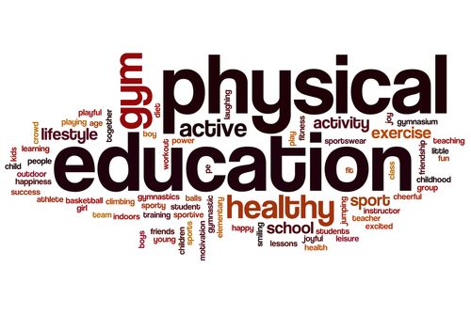


SHRI GURU GOBIND SINGH JI GOVT. COLLEGE,
PAONTA SAHIB, SIRMOUR (H.P)

Slide 2

B.A. 2nd YEAR
COURSE NAME: SPORTS TRAINING
COURSE CODE: PED204TH

Slide 3

WARMING UP

Slide 4
TOPICS TO BE COVERED
MEANING OF WARMING UP
TYPES OF WARMING UP
IMPORTANCE OF WARMING UP
MEANING OF COOLING DOWN

Slide 5
MEANING OF WARMING UP
Warm-up: It is a primarily preparatory activity in which physiological and psychological preparation of athlete for the main activity, takes place.
Warming up helps prepare your body for aerobic activity. A warmup gradually revs up your cardiovascular system by raising your body temperature and increasing blood flow to your muscles. Warming up may also help reduce muscle soreness and lessen your risk of injury.

Slide 6
TYPES OF WARMING UP
There are two types of warming-up viz.
General Warming-up and Specific Warming-up. These are described below :
General Warming-up.
General warming- up is usually performed in all types of activities. This type of warming-up includes jogging, running, jumping, stretching, callisthenics striding, wind sprints and other general exercises. It increases coordinative abilities, and flexibility of muscles and joints. It also improves muscle tone. The duration of general warming-up depends upon the nature of work to be performed.
Specific Warming-up.
In specific warming- up, exercises are done with implements. Special exercises are performed which have direct relationship with the activity to be done. These specific exercises are performed after the activities of general warming-up. Specific type .of warming-up differs from activity to activity which means game to game, For example, a sprinter may take few starts and run for short distance before the actual competition. A basketball player may practise for lay up shots or free throws practise for lay up shots or free throws before the competition. This type of warming-up improves the coordinative abilities. In fact, in specific warming-up, the main stress is laid on the practice of various skills which are to be performed in the game. The exercises, which are usually performed in specific warming-up,

Slide 7
IMPORTANCE OF WARMING UP
Improves blood flow and oxygen efficiency
Warm-up exercises open up blood capillaries and boost blood flow to skeletal muscles. Muscles need oxygen to function as you exercise, so increasing blood flow sets muscles up for the intense activity to follow. Warm-up exercises also releases oxygen from the blood more readily, and this is a positive because while exercising, your muscles need higher amounts of oxygen.

Slide 8
Improves performance
Warm-up exercises help your muscles contract and relax faster. Warming up raises body temperature, which leads to improved nerve transmission and muscle metabolism, further leading to efficient muscle performance.
Reduces risk of injury
Apart from improved blood flow, warm-up exercises help loosen joints. Both these factors make your muscles less likely to get ripped, torn, twisted, or injured in any way during your high-intensity workout. By performing warm-up exercises, you also become mentally prepared for exercising and focused on your training session, thereby reducing risk of injury. Focusing on the workout also helps you improve your technique and form.
Reduces stress on cardiovascular system
Warming up gradually increases heart rate and breathing, helping you avoid placing stress on the heart and lungs.

Slide 9
MEANING OF COOLING DOWN
Cooling down after your workout allows for a gradual recovery of preexercise heart rate and blood pressure.
Cooling down is similar to warming up. You generally continue your workout session for five minutes or so, but at a slower pace and reduced intensity.
Here are some examples of cool-down activities:
  To cool down after a brisk walk, walk slowly for five to 10 minutes.
  To cool down after a run, walk briskly for five to 10 minutes.
  To cool down after swimming, swim laps leisurely for five to 10 minutes

Slide 10


